Slide 1

SWE 321: Data Communication
SWE 321- Lecture 05
Afsana Begum
Department of Software Engineering
Daffodil International University

Slide 2
Overview:
Review
Digital Transmission
Digital –to- Digital Conversion
Line Coding
Signal Element Versus Data Element
Data Rate Versus Signal Rate
Line Coding Schemes
Uni-polar, Polar, Bi-polar Line coding Techniques

Slide 3
Digital Transmission:
Objectives:
A computer network is designed to send information from one point to another. This information needs to be converted to either a digital signal or an analog signal for transmission.
In this lecture, we show the schemes and techniques that we use to transmit data digitally.
First, we discuss digital-to-digital conversion techniques, methods which convert digital data to digital signals.
Second, we discuss analog-to-digital conversion techniques, methods which change an analog signal to a digital signal.

Slide 4
Digital Transmission:
Digital – To – Digital Conversion:
The conversion involves three techniques:
Line coding
Block coding and
Scrambling
Line coding is always needed where block coding and scrambling may or may not be needed.
So, here we only emphasize on Line Coding !!!

Slide 5
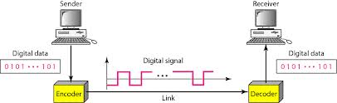
Digital Transmission:
Line Coding:
Line coding is the process of converting digital data to digital signals.
Line coding converts a sequence of bits to a digital signal.
At the sender, digital data are encoded into a digital signal; at the receiver, the digital data are recreated by decoding the digital signal.

Slide 6
Digital Transmission:
Signal Element Versus Data Element:
Data Element: In data communications, our goal is to send data elements. A data element is the smallest entity that can represent a piece of information: this is the bit.
Signal Element: A signal element carries data elements. A signal element is the shortest unit (time wise) of a digital signal.
Relation: Data elements are what we need to send; signal elements are what we can send. Data elements are being carried; signal elements are the carriers.

Slide 7
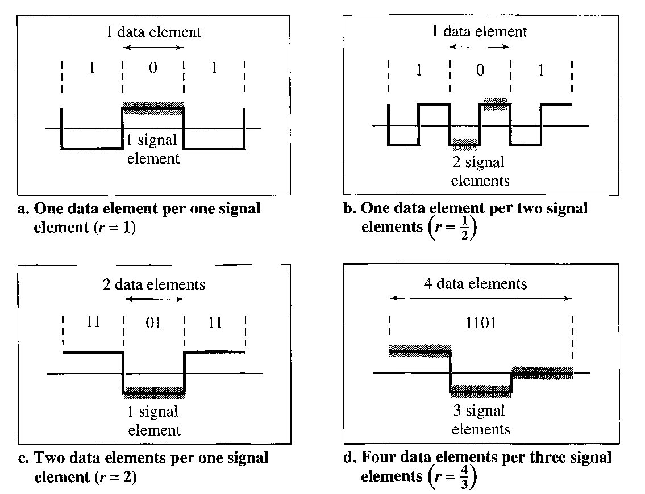
Digital Transmission:
Signal Element Versus Data Element:

Slide 8
Digital Transmission:
Data Rate Versus Signal Rate:
Data Rate: The data rate defines the number of data elements (bits) sent in 1s. The unit is bits per second (bps). The data rate is sometimes called the bit rate.
Signal Rate: The signal rate is the number of signal elements sent in 1s. The unit is the baud. the signal rate is sometimes called the baud rate.
Relation: One goal in data communications is to increase the data rate while decreasing the signal rate. Increasing the data rate increases the speed of transmission; decreasing the signal rate decreases the bandwidth requirement.

Slide 9
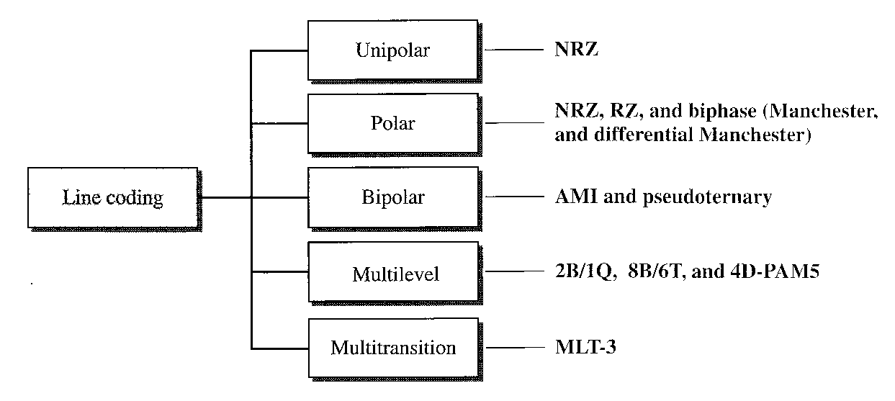
Digital Transmission:
Line Coding Schemes:
We can roughly divide line coding schemes into five broad categories, as shown in Figure:

Slide 10
Digital Transmission:
Uni-Polar Scheme :
NRZ (Non-Return-to-Zero):
As a uni-polar scheme, all the signal levels are on one side of the time axis, either above or below.
In this scheme the positive voltage defines bit 1 and the zero voltage defines bit O. It is called NRZ because the signal does not return to zero at the middle of the bit.
Compared with its polar counterpart this scheme is very costly. The normalized power is double compare to polar NRZ. For this reason, this scheme is normally not used in data communications today.

Slide 11
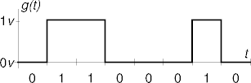
Digital Transmission:
NRZ (Non-Return-to-Zero):

Slide 12
Digital Transmission:
Polar Schemes:
Non-Return-to-Zero (NRZ):
In this schemes, the voltages are on the both sides of the time axis. For example, the voltage level for 0 can be positive and the voltage level for 1 can be negative. We can have two versions of polar NRZ: NRZ-L and NRZ-I
NRZ-L (Non-return-to-zero, Level): In NRZ-L the level of the signal is dependant upon the state of the bit. A positive voltage usually means the bit is 0, and negative voltage means the bit is a 1 (And Vice Versa).

Slide 13
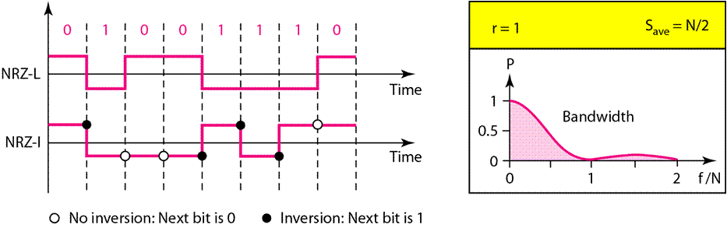
Digital Transmission:
Polar Schemes:
NRZ-I (Non-return-to-zero, Invert): In NRZ-I, an inversion of the voltage level represents a 1 bit. It is the transition between a positive and a negative voltage, not the voltages themselves that represents a 1 bit. A 0 bit is represented by no change.

Slide 14
Digital Transmission:
Polar Schemes:
RZ (Return-to-zero) :
To assure synchronization, there must be a signal change for each bit. The receiver can use these changes to built up, update, and synchronies its clock.
One solution is return to zero (RZ) encoding, which uses three Values: positive, negative, and zero. In RZ, the signal changes not between bits but during the bit.
The main disadvantage of RZ encoding is that it requires two signal changes to encode one bit and therefore occupies more bandwidth.

Slide 15
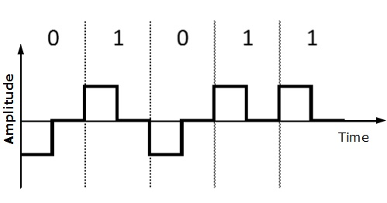
Digital Transmission:
Polar Schemes:
RZ (Return-to-zero) :

Slide 16
Digital Transmission:
Polar Scheme:
Bi-phase:
Probably the best existing solution to the problem of synchronization is bi-phase encoding.
In this method, the signal changes at the middle of the bit interval but does not return to zero. Instead it continues to the opposite pole.
As in RZ, these mid-interval transitions allow for synchronization.
Bi-phase encoding is implemented in two different ways: Manchester and Differential Manchester.

Slide 17
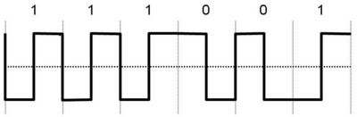
Digital Transmission:
Polar Scheme:
Bi-phase:
Manchester Coding:
Manchester encoding uses the inversion at the middle of each bit interval for both synchronization and bit representation.
A negative-to-positive transition represents binary 1 and a positive-to-negative transition represents binary 0. Here the duration of the bit is divided into two halves.

Slide 18
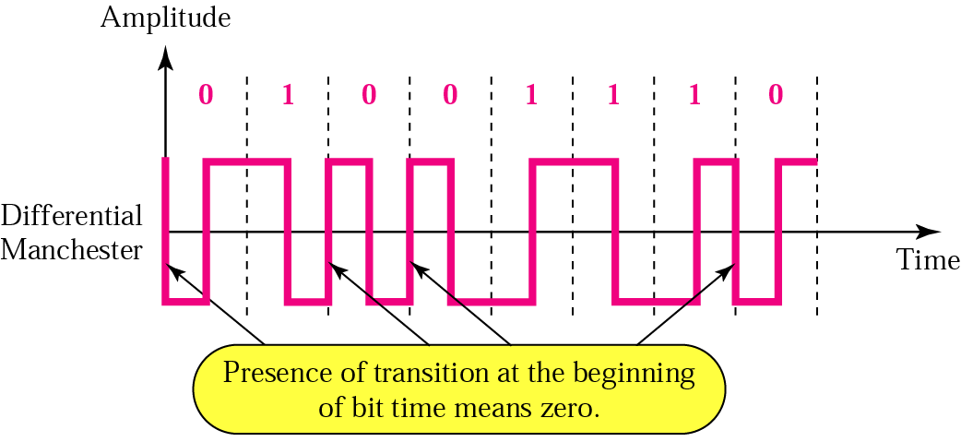
Digital Transmission:
Polar Scheme:
Differential Manchester :
In this method, the inversion at the middle of the bit is used for synchronization, but the presence or absence of an additional transition at the beginning of the interval is used to identify the bit.
A transition means binary 0 and no transition means binary 1

Slide 19
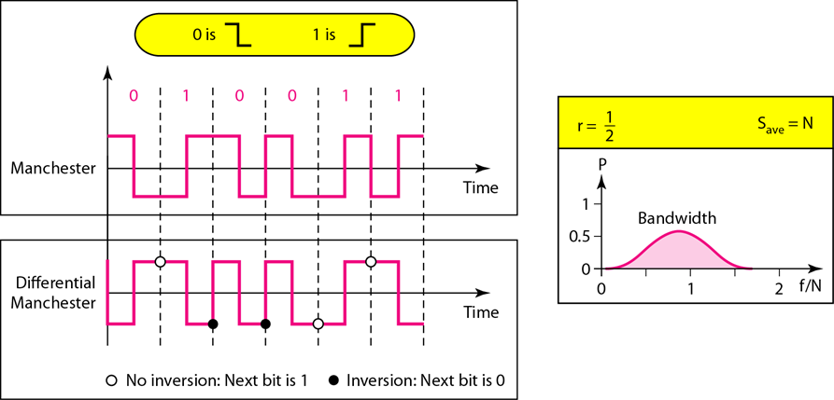
Digital Transmission:
Bi-phase Scheme:
Manchester & Differential Manchester:

Slide 20
Digital Transmission:
Bipolar Scheme:
Bipolar encoding uses three voltage levels: positive, negative and zero.
The zero level is used to represent binary 0 positive and negative voltages represent alternating 1s.
Three types of bipolar encoding are popular use by the data communications industry: AMI, B8ZS, and HDB3.
Here only AMI (Alternate Mark Inversion ) encoding technique will be discussed.

Slide 21

Digital Transmission:
Bipolar Scheme:
Alternate Mark Inversion (AMI):
Bipolar AMI is the simplest type of bipolar encoding. The word mark comes from telegraphy and means 1.
AMI means alternate 1 inversion. A neutral, zero voltage represents binary 0. Binary 1s are represented by alternating positive and negative voltages.

Slide 22
Thanks…
Any Questions ???

